Slide 1
Assignment 11 AML SHAP Values Part 1
5420 Anomaly Detection, Fall 2020
- Harsh Dhanuka, hd2457

Slide 2

5420 Anomaly Detection, Fall 2020
- Harsh Dhanuka, hd2457
Agenda
LOAN DEFAULT
Loan default occurs when a borrower fails to pay back a debt according to the initial arrangement.
Predict which loan holders will likely default
0 = No Default 1 = Default
Which techniques to use?
Which packages to use?
How to convey the results?
How to justify whether to provide a loan or not?
How to analytically decode if a person is likely to default?
Around $20 billion defaults only in student loans in US

Slide 3
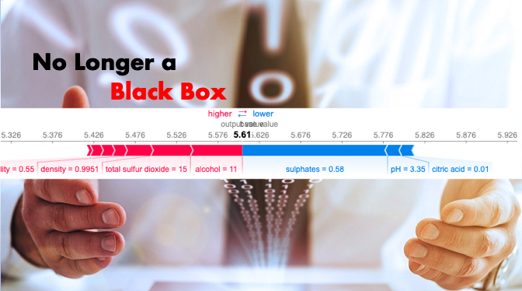
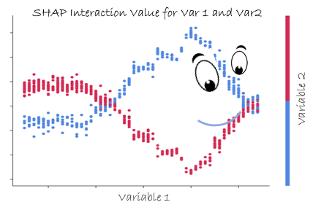
SHAP Values
SHAP Values (an acronym from SHapley Additive exPlanations) break down a prediction to show the impact of each feature on the prediction. It is a method to explain individual predictions. SHAP is based on the game theoretically optimal Shapley Values.
Use case: A model says a bank shouldn't loan someone money, and the bank is legally required to explain the basis for each loan rejection.
Three benefits:
1. Global interpretability — the collective SHAP values can show how much each predictor contributes, positively or negatively, to the target variable.
2. Local interpretability — each observation gets its own set of SHAP values. We can explain why a case receives its prediction and the contributions of the predictors.
3. The SHAP values can be calculated for any tree-based model, while other methods use linear regression or logistic regression models as the surrogate models.

Slide 4
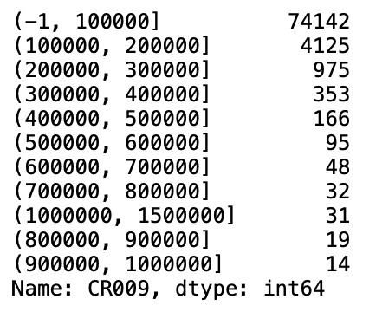
5420 Anomaly Detection, Fall 2020
- Harsh Dhanuka, hd2457
Considerations
1. Feature Engineering
Convert Date/Time columns
Education Code, Gender, City, etc converted to objecttype
Drop empty value variables and constants
Bin the Loan Amount column
2. Missing values
Convert mis-represented NA’s such as -99, -999, etc to np.nan
Use Smart Iterative Imputer to fill with median
3. Select 10 most important variables (based on previous models)
4. Dummy coding of Categorical Variables
5. Split to Train_Test (75:25 split)
Loan Amount Bin ($) Count

Slide 5
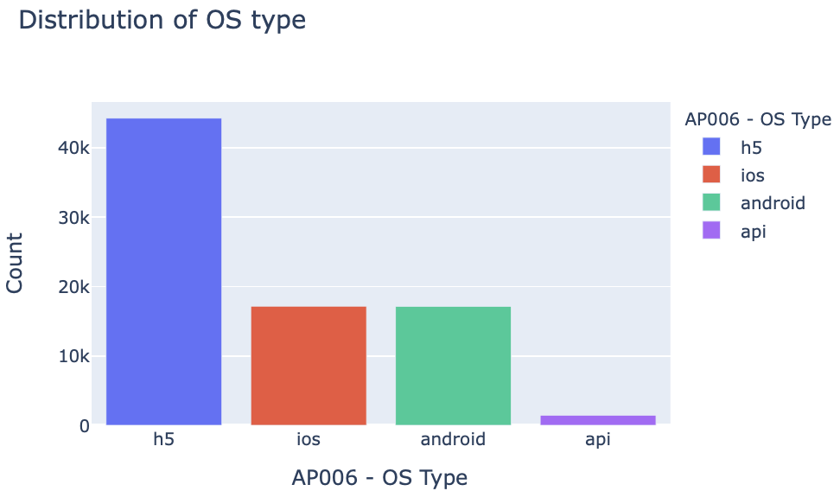
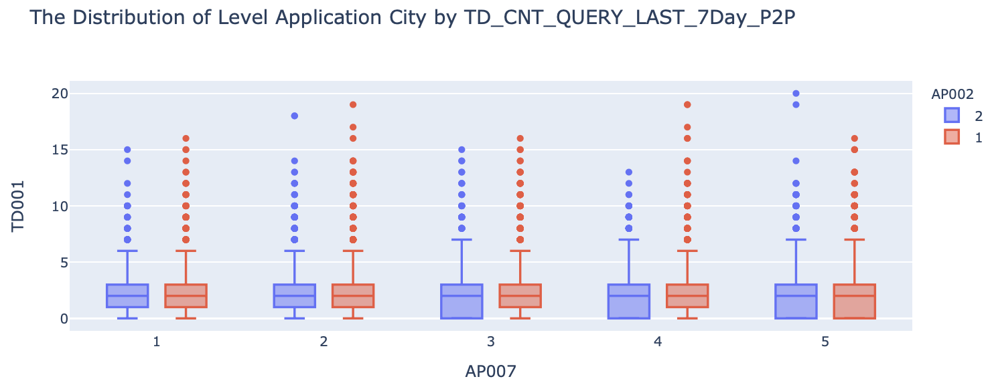
5420 Anomaly Detection, Fall 2020
- Harsh Dhanuka, hd2457
Exploratory Data Analysis
1
Distribution of AP006 – OS Type
2
Distribution of Application City (AP007) by the Count of Query in 7 days
Colored by Gender (AP002)

Slide 6
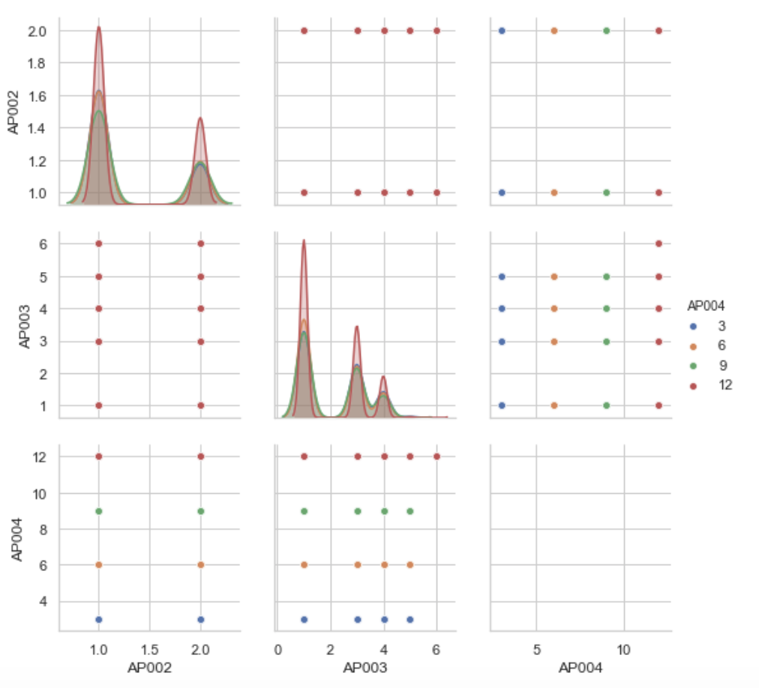
5420 Anomaly Detection, Fall 2020
- Harsh Dhanuka, hd2457
Exploratory Data Analysis
Checking relations between:
AP002 – Gender
AP003 – Education Code
AP004 – Loan Term
3

Slide 7
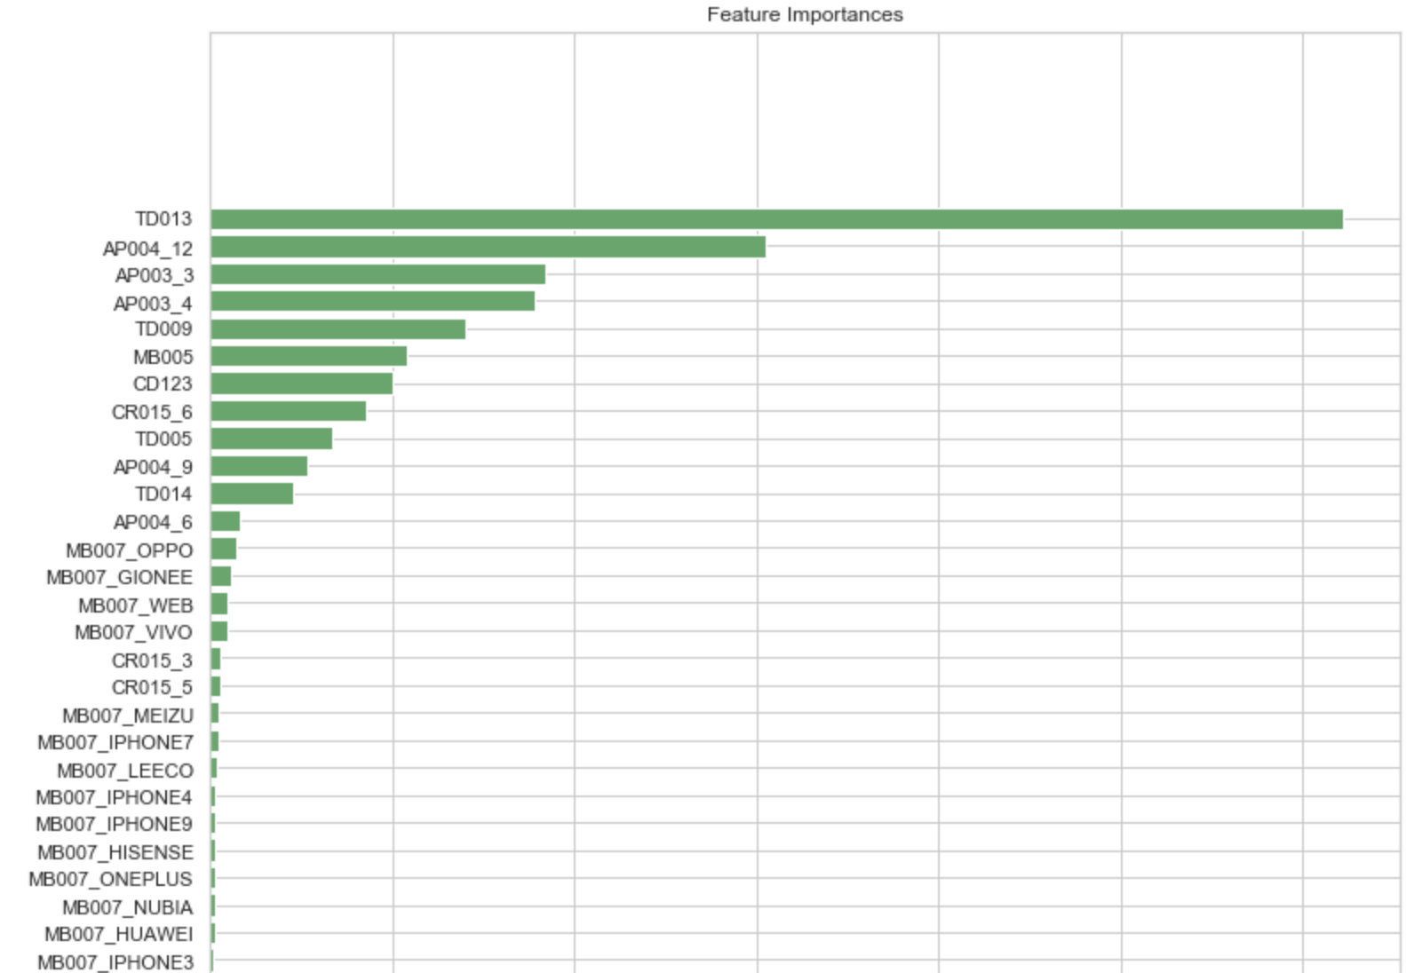
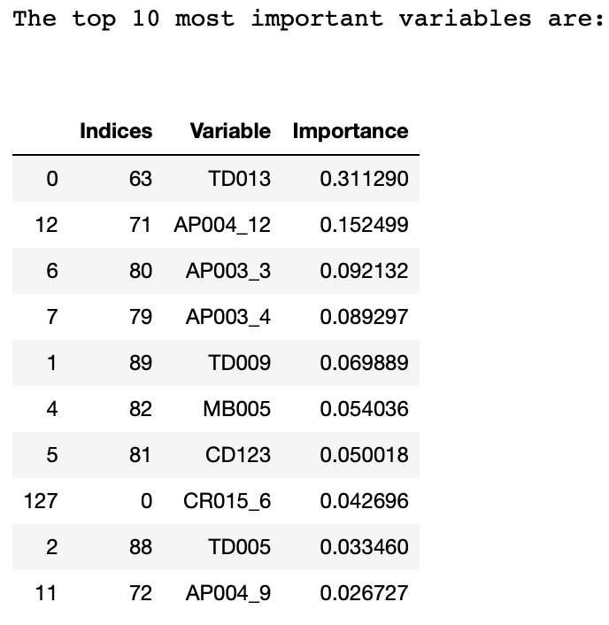
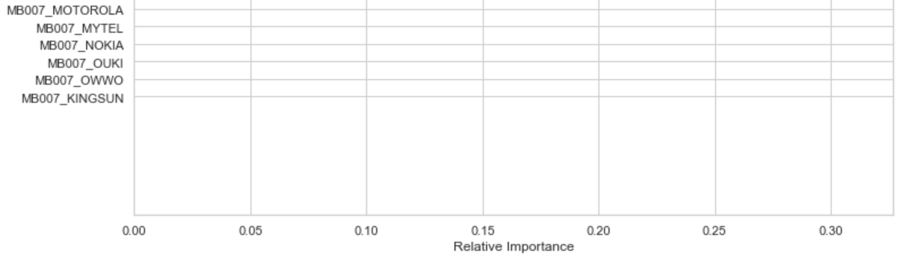
5420 Anomaly Detection, Fall 2020
- Harsh Dhanuka, hd2457
Random Forest Model
2
Check Variable Importance as per RF
1
Run a basic sklearn RF Model
max_depth = 6
random_state = 0
n_estimators=10)

Slide 8
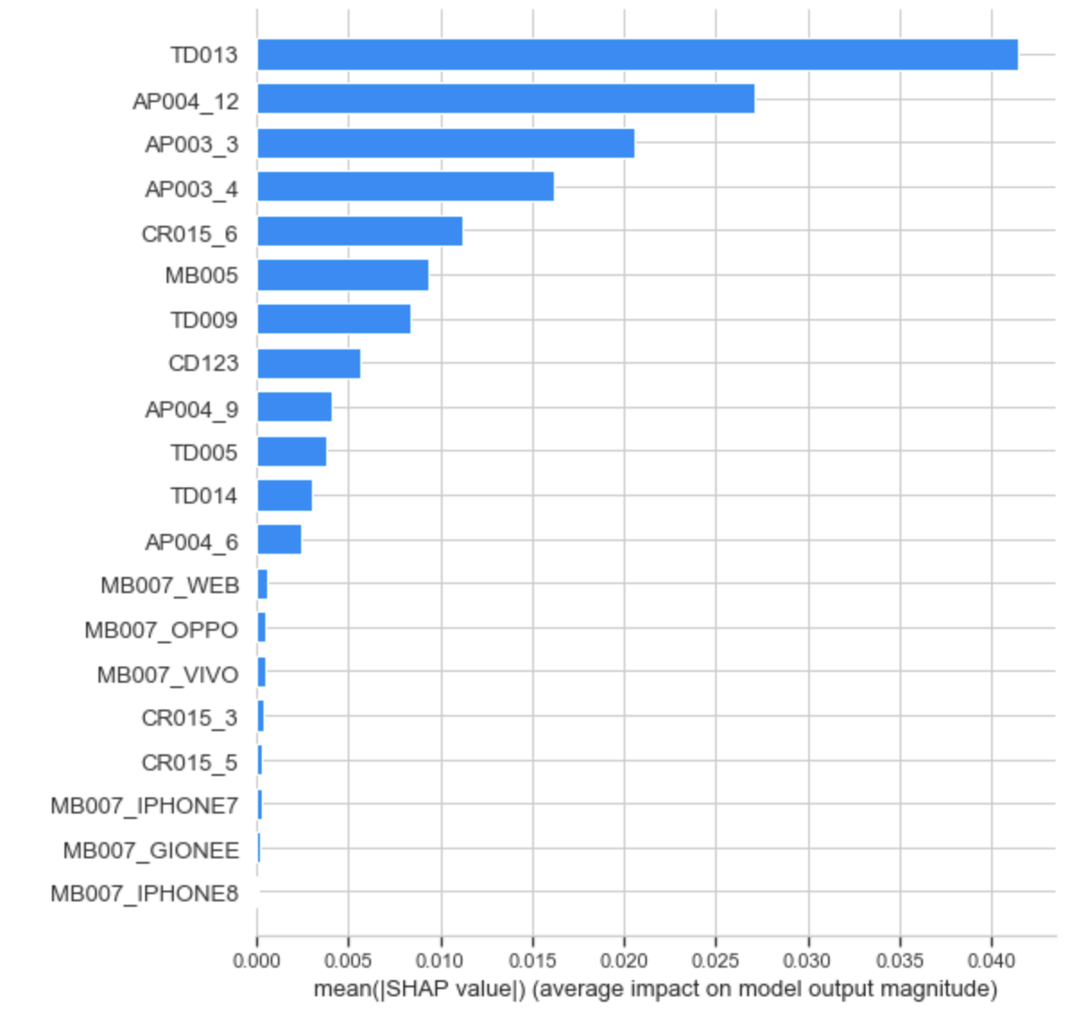
5420 Anomaly Detection, Fall 2020
- Harsh Dhanuka, hd2457
SHAP Values
Global Interpretability
1
Variable Importance Plot
The ‘bar’ SHAP summary plot gives us the basic Variable Importance Plot, based on the variable SHAP values.
Most important variables are:
TD013 – Count of Queries in past 6 months
AP004_12 – Loan Term of 12 years
AP003_3 – Education Code, Level 3
How do they affect the loan default value?
What is their relationship?

Slide 9
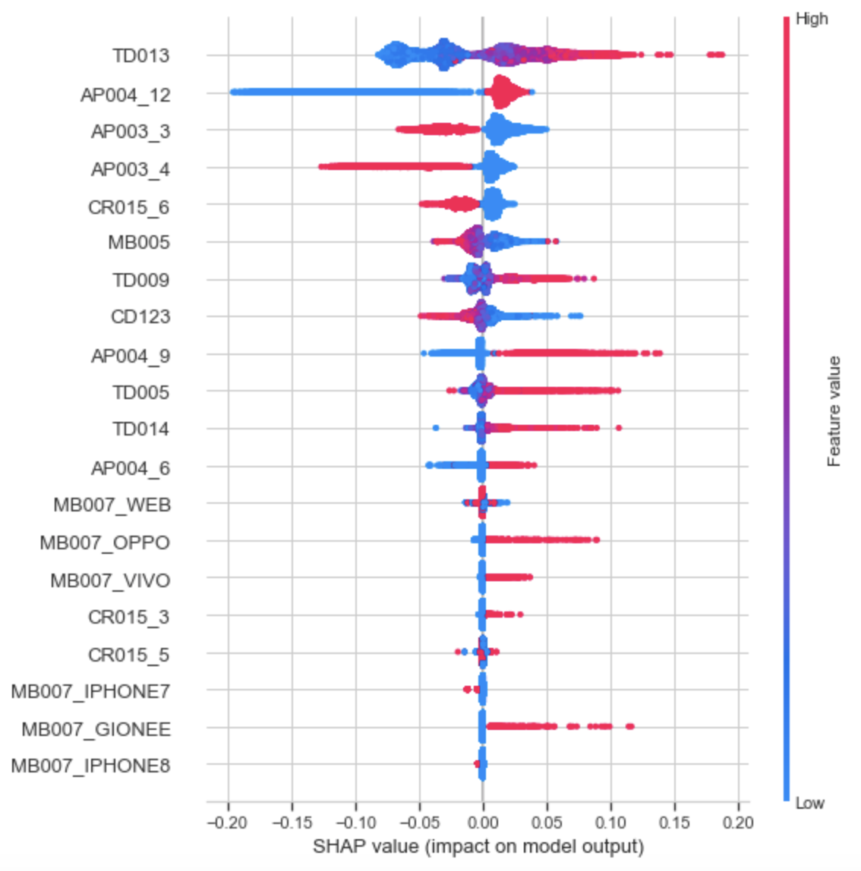
5420 Anomaly Detection, Fall 2020
- Harsh Dhanuka, hd2457
SHAP Values
2
SHAP Summary Plot

Slide 10
5420 Anomaly Detection, Fall 2020
- Harsh Dhanuka, hd2457
SHAP Values
2
SHAP Summary Plot
Business Insights:
Relationship of top 5 variables with the target variable
TD013 - Count of Queries in Last 6 months: Positive
High value ⇒ high value of loan default
AP004_12 - Loan Term of 12 years: Positive
High value ⇒ high value of loan default
AP003_3 - Education Code Level 3: Negative
High value ⇒ low value of loan default
AP003_4 - Education Code Level 4: Negative
High value ⇒ low value of loan default
CR015_6 - Months of Credit Card Max Level 6:
Negative
High value ⇒ low value of loan default

Slide 11
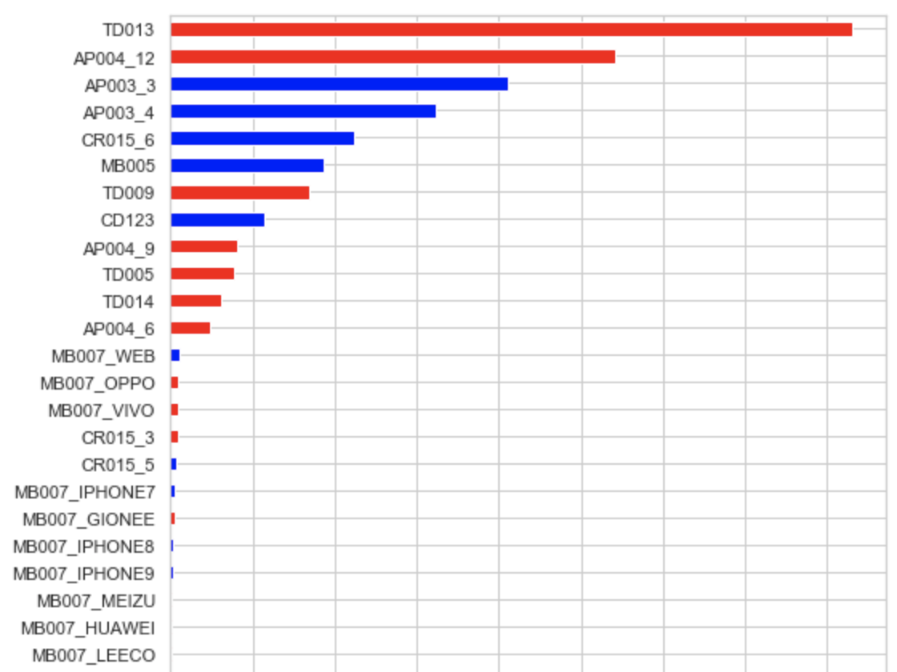
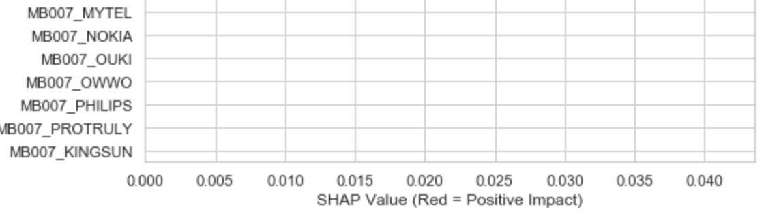
5420 Anomaly Detection, Fall 2020
- Harsh Dhanuka, hd2457
SHAP Values
3
SHAP Summary Plot
This plot simplifies the summary, and only shows us the positive vs the negative impact variables.
Red = Positive Impact
Blue = Negative Impact

Slide 12
5420 Anomaly Detection, Fall 2020
- Harsh Dhanuka, hd2457
SHAP Values
3
SHAP Summary Plot
This plot simplifies the summary, and only shows us the positive vs the negative impact variables.
Business Insight: A high chance/value of loan default is associated with the following characteristics:
High TD013
High AP004_12
Low AP003_3
Low AP003_4
Low CR015_6
Low MB005
Low CD123
High TD009
High TD005
High AP004_9
High TD014
High AP004_6
Red = Positive Impact
Blue = Negative Impact

Slide 13
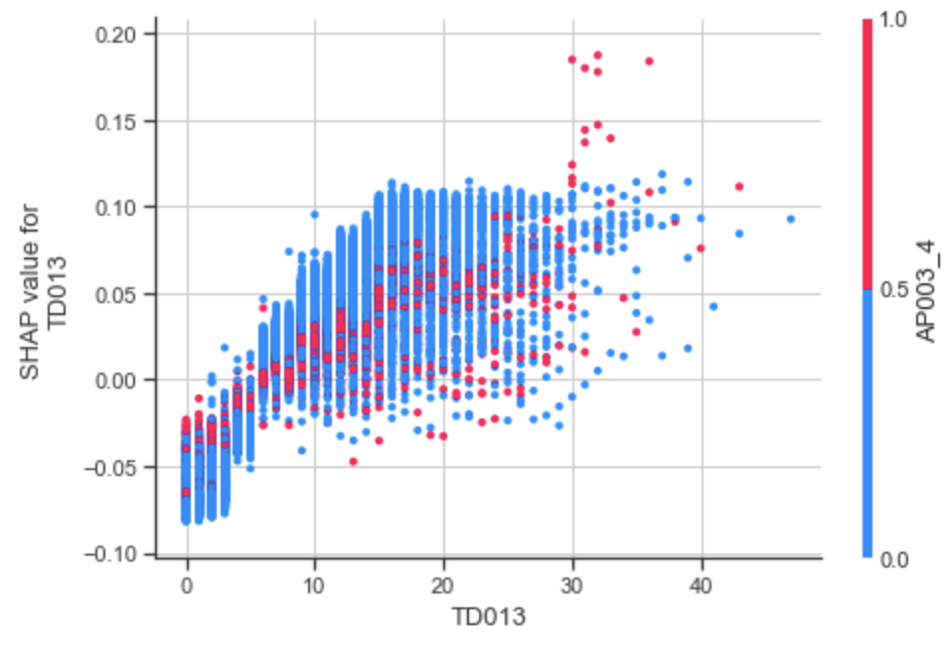
5420 Anomaly Detection, Fall 2020
- Harsh Dhanuka, hd2457
SHAP Values
4
SHAP Variable Dependence Plots
To understand how a single feature effects the output of the model, we can plot the SHAP value of that feature vs the value of the feature for all the examples in the dataset.
Dependence Plot for TD013

Slide 14
5420 Anomaly Detection, Fall 2020
- Harsh Dhanuka, hd2457
SHAP Values
4
SHAP Variable Dependence Plots
To understand how a single feature effects the output of the model, we can plot the SHAP value of that feature vs the value of the feature for all the examples in the dataset.
Business Insights:
TD013 - Count of queries in last 6 months
High value leads to increase in value of loan default
AP004_12 - Loan term of 12 years
High value leads to increase in value of loan default
3. There are more red points (high AP004_12), in the areas where TD013 is high.
- There is an approximately linear positive trend between “TD013” and the target variable
- “TD013” interacts with “AP004_12” frequently.
Dependence Plot for TD013

Slide 15
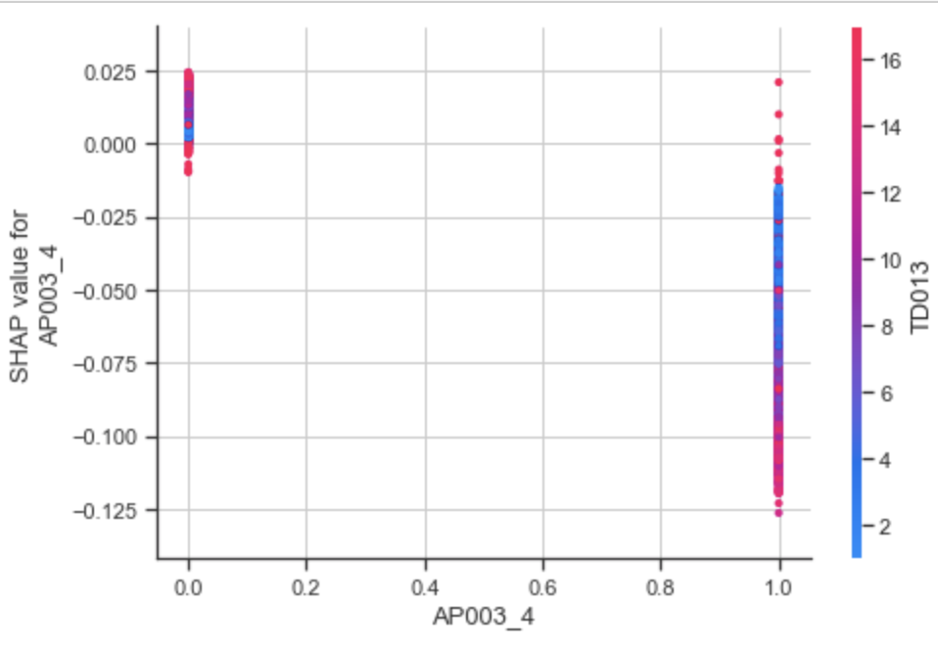
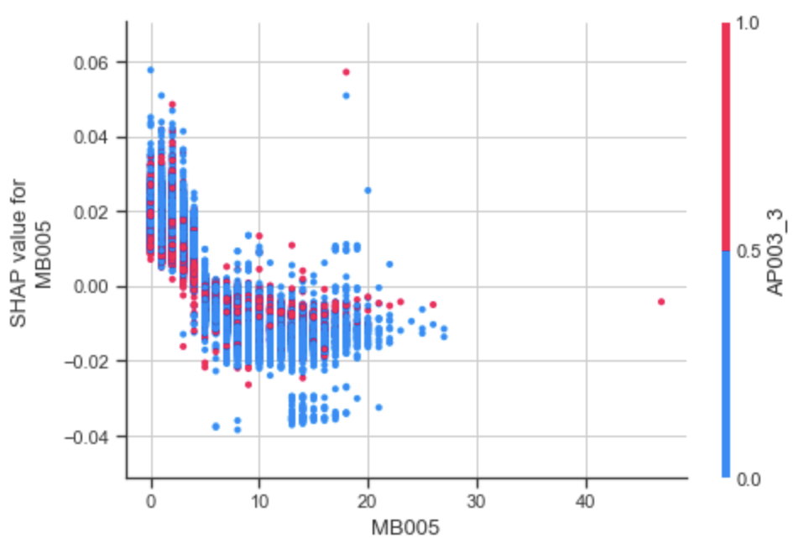
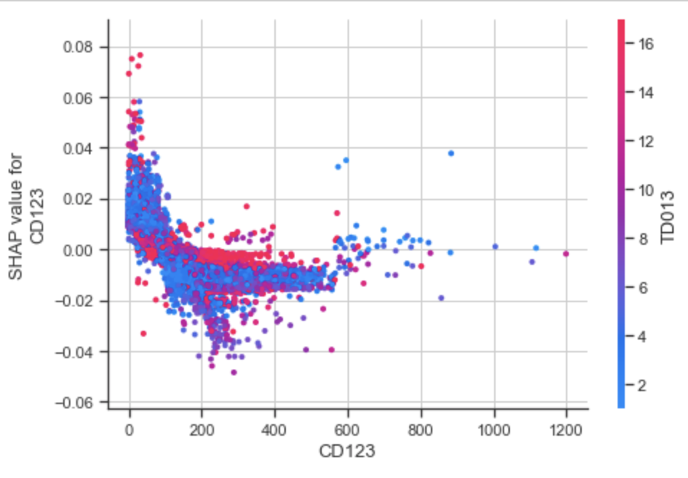
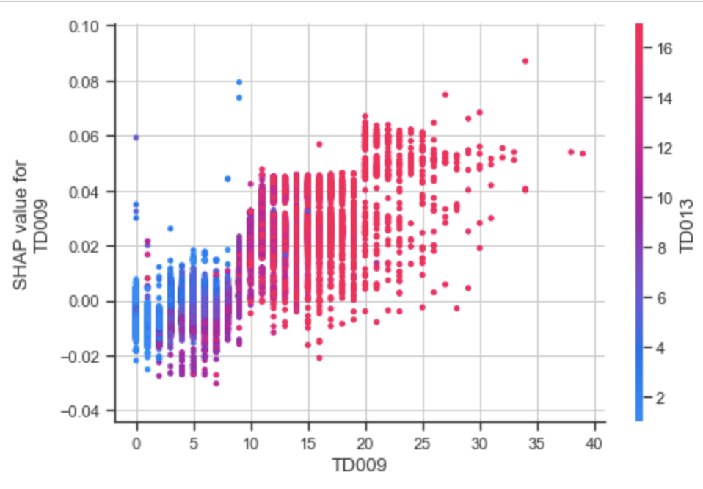
…..continued
5420 Anomaly Detection, Fall 2020
- Harsh Dhanuka, hd2457
Dependence Plot for AP003_4
(Education Code Level 4)
Dependence Plot for MB005
(Years Phone is Active)
Dependence Plot for CD123
(Count of Distinct Outbound Calls in Past 3 months)
Dependence Plot for TD009
(Count of Queries in past 3 months)

Slide 16
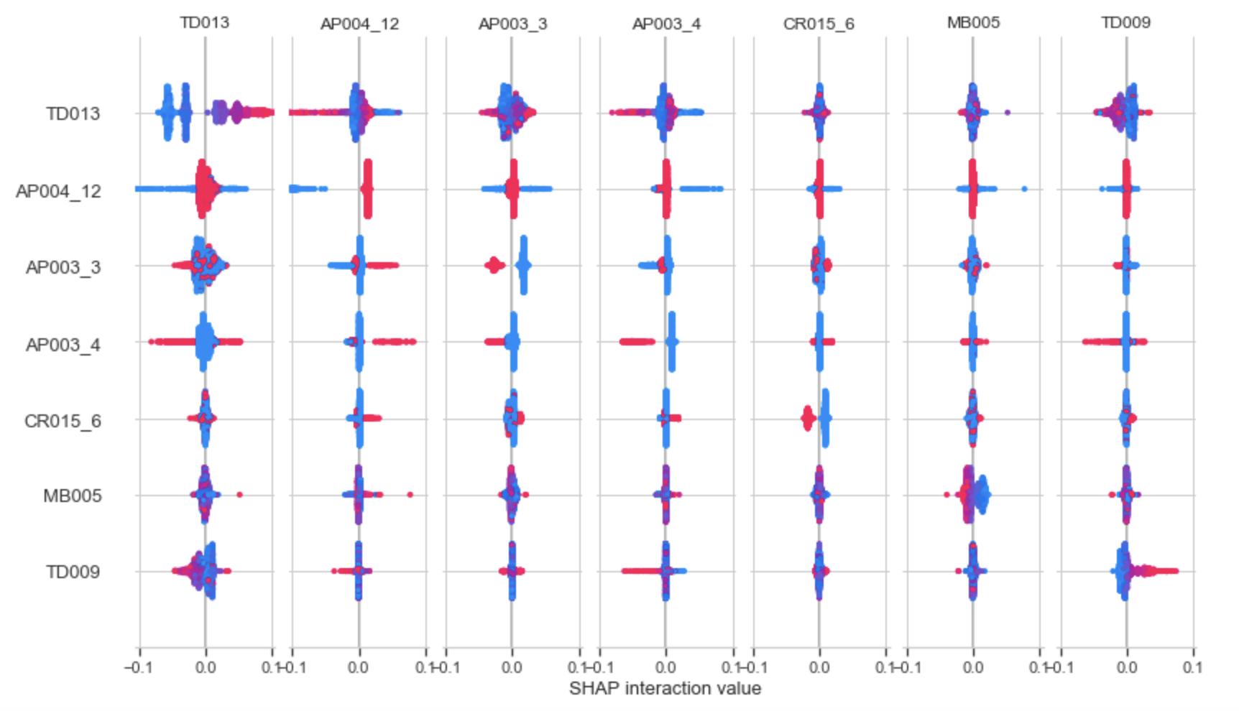
5420 Anomaly Detection, Fall 2020
- Harsh Dhanuka, hd2457
SHAP Values
5
SHAP Multiple Variable Dependence Plots
For the top 6 variables, it shows the other top 6 variables it interacts with, and their impact on the loan default value.

Slide 17
SHAP Values
5420 Anomaly Detection, Fall 2020
- Harsh Dhanuka, hd2457
Local Interpretability
6
Individual SHAP Value Plots / Force Plots
The force plots help explain the predicted value for each observation.

Slide 18
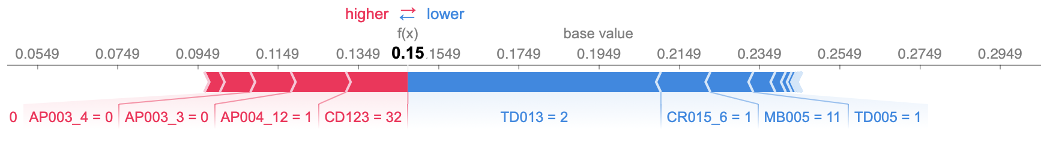
SHAP Values
5420 Anomaly Detection, Fall 2020
- Harsh Dhanuka, hd2457
Local Interpretability
6
Individual SHAP Value Plots / Force Plots
The force plots help explain the predicted value for each observation.
Red = Positive Impact, push right
Blue = Negative Impact, push left
Force Plot for Observation 1

Slide 19
SHAP Values
5420 Anomaly Detection, Fall 2020
- Harsh Dhanuka, hd2457
Local Interpretability
6
Individual SHAP Value Plots / Force Plots
The force plots help explain the predicted value for each observation.
Red = Positive Impact, push right
Blue = Negative Impact, push left
Force Plot for Observation 1
Business Insights:
Output value: This is the prediction for that observation, which here is 0.15, lower than the mean of 0.19
Base value: The value that would be predicted if we did not know any features for the current output
TD013 or Count of Queries in the past 6 months: Negative impact. Value is 2 which is lower than the average value 6.81.
A low value results in a less likely loan default, this value is low here, it pushes towards a less likely loan default, to the left.
CD123 or Count of Distinct Outbound call in past 3 months: Positive impact. Value is 32 which is lower than its average of 121.59, A low value results in a more likely loan default, this value is low here, it pushes towards a more likely loan default, to the right.

Slide 20
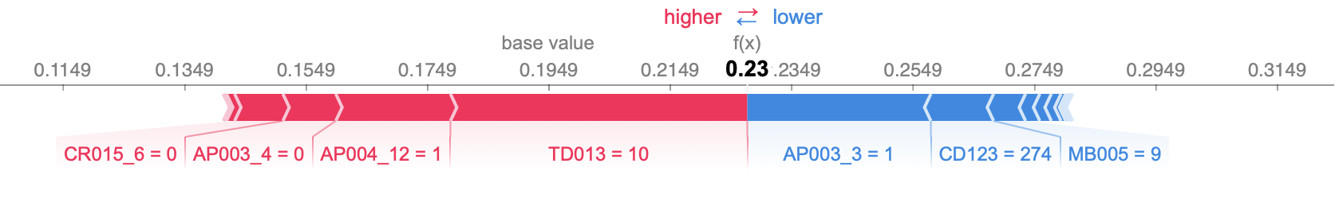
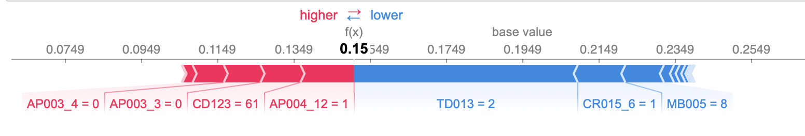
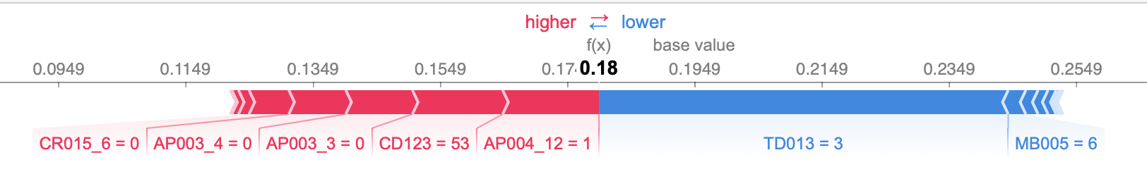
…..continued
5420 Anomaly Detection, Fall 2020
- Harsh Dhanuka, hd2457
Force Plot for Observation 2
Force Plot for Observation 3
Force Plot for Observation 4

Slide 21
5420 Anomaly Detection, Fall 2020
- Harsh Dhanuka, hd2457
Conclusion
SHAP Values are a very important methodology to understand and explain the variables which result a certain prediction value in a random forest model.
Three benefits:
1. Global interpretability — the collective SHAP values can show how much each predictor contributes, positively or negatively, to the target variable.
2. Local interpretability — each observation gets its own set of SHAP values. We can explain why a case receives its prediction and the contributions of the predictors.
3. The SHAP values can be calculated for any tree-based model, while other methods use linear regression or logistic regression models as the surrogate models.

Slide 22
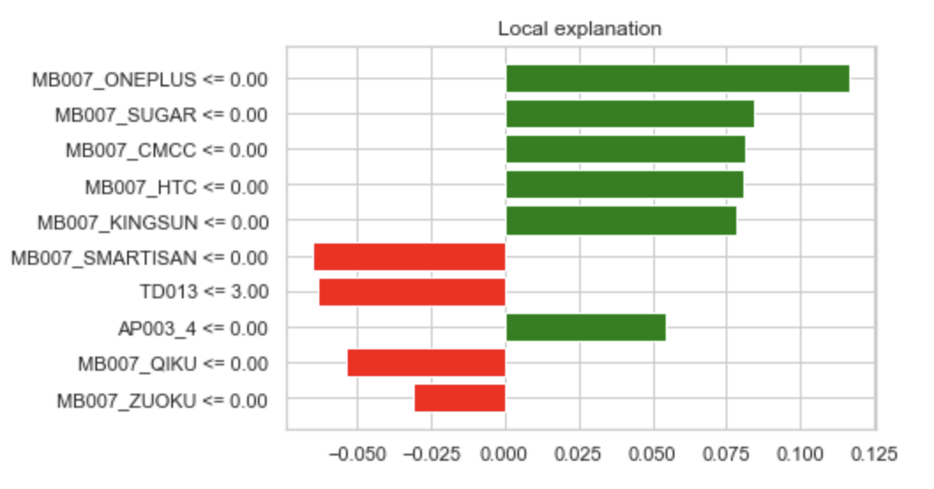
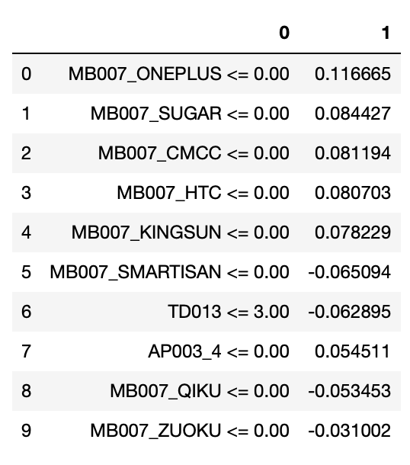
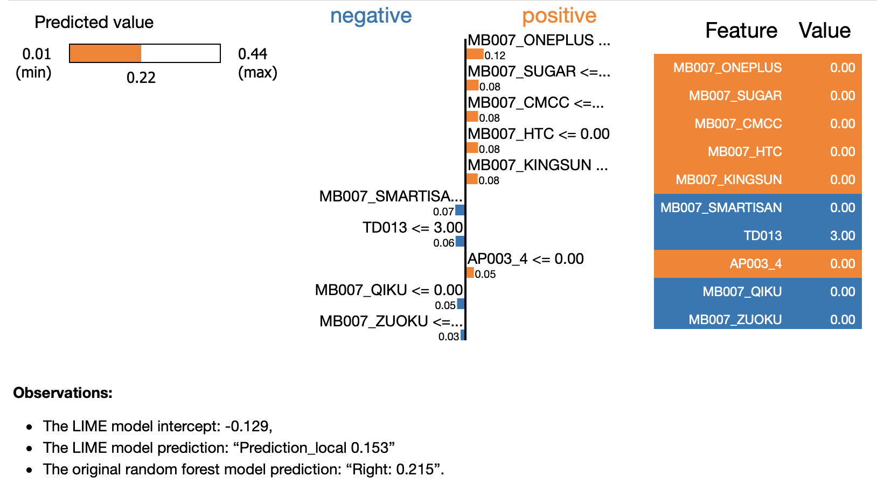
FUTURE CONSIDERATIONS
5420 Anomaly Detection, Fall 2020
- Harsh Dhanuka, hd2457
LIME Model
LIME (Local Interpretable Model-agnostic Explanations) builds sparse linear models around an individual prediction in its local vicinity. This is documented in Lundberg and Lee (2016) that LIME is actually a subset of SHAP but lacks the same properties.

Slide 23
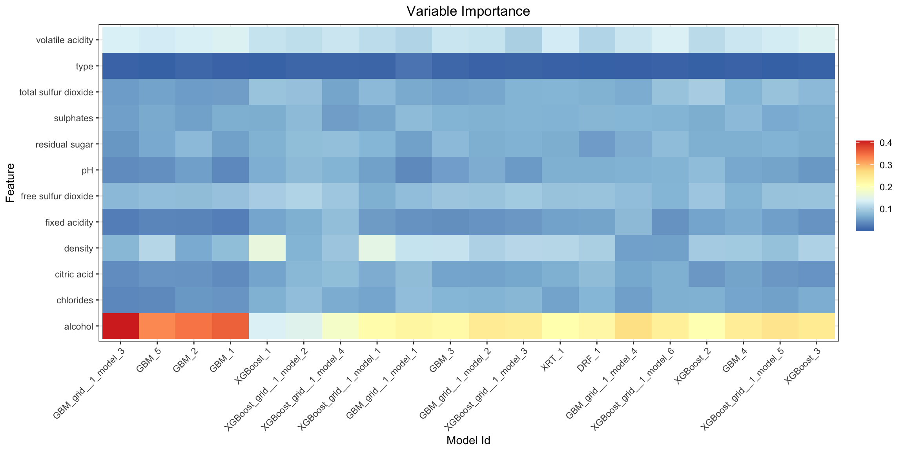
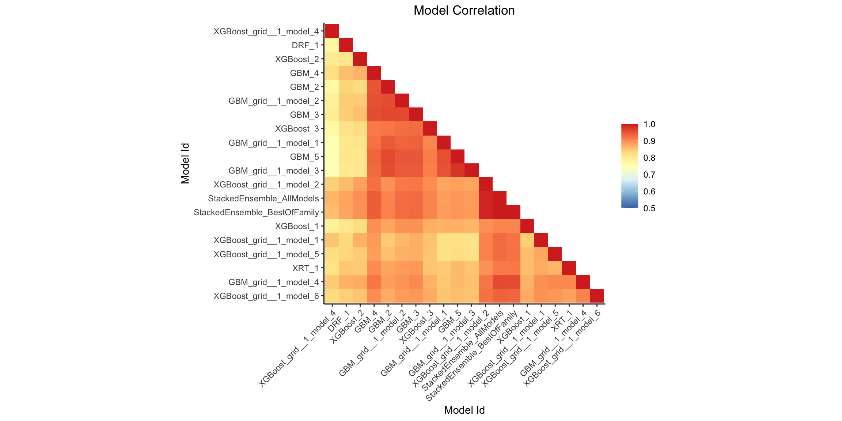
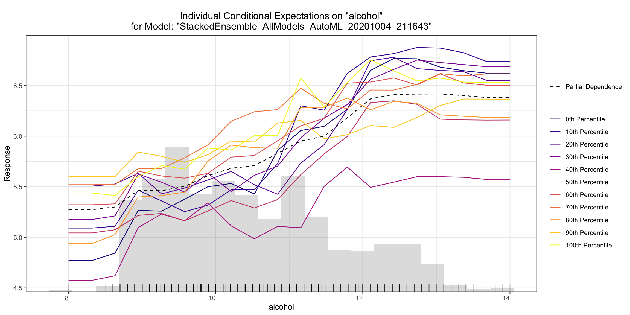
FUTURE CONSIDERATIONS
5420 Anomaly Detection, Fall 2020
- Harsh Dhanuka, hd2457
For Feature Importance

